Slide 1
Historic Year 2019-2023 and Forecast to 2032
Global Sea Food Market
Type: Fish, Crustaceans, Mollusks, Other Seafood Product Type: Fresh, Frozen Dried, Smoked, Canned Nature: Organic, Conventional Distribution Channel: Supermarkets, Convenience Stores, Specialty Stores, Online Sales Channel, Other Distribution Channels By Region: North America, Europe, Asia-Pacific, Latin America, Middle East & Africa

Slide 2
MARKET SEGMENTATION
Global Sea Food Market(USD BILLION)
YEARS CONSIDERED :
Historical year - 2019-2023 | Base year - 2024 | Forecast year - 2025-2032
BY TYPE
BY PRODUCT TYPE
BY NATURE
BY DISTRIBUTION CHANNEL
Fish
Crustaceans
Mollusks
Other Seafood
Fresh
Frozen Dried
Smoked
Canned
Organic
Conventional
Supermarkets
Convenience Stores
Specialty Stores
Online Sales Channel
Other Distribution Channels

Slide 3








MARKET TAXONOMY
Global Sea Food Market(USD BILLION)
YEARS CONSIDERED :
Historical year - 2019-2023 | Base year - 2024 | Forecast year - 2025-2032
NORTH AMERICA
EUROPE
ASIA PACIFIC
LATIN AMERICA
MIDDLE EAST & AFRICA
Mexico
GCC Countries
United Kingdom
China
Brazil
Canada
Germany
France
Japan
Spain
South Korea
United States
Italy
India
South Africa
United Kingdom
Germany
France
Spain
GCC Countries
South Africa
Rest of MEA
Italy
Rest of Europe
China
Japan
India
Brazil
Mexico
Rest of LATAM
United States
Canada
South Korea
Rest of APAC

Slide 4
TABLE OF CONTENTS-
Global Sea Food Market-
Historic Year 2019-2023 and Forecast to 2032

Slide 5

TABLE OF CONTENTS
1. Introduction | 4.6.1. Competitive Rivalry
1.1. Objectives of the Study | 4.6.2. Threat of substitutes
1.2. Market Definition & Scope | 4.6.3. Bargaining power of buyers
2. Research Methodology | 4.6.4. Threat of new entrants
2.1. Research Process | 4.6.5. Bargaining power of suppliers
2.2. Secondary & Primary Data Methods | 5. Key Market Insights
2.3. Market Size Estimation Methods | 5.1. Key Success Factors
2.4. Market Assumptions & Limitations | 5.2. Market Impacting Factors
3. Executive Summary | 5.3. Top Investment Pockets
3.1. Global Market Outlook | 5.4. Market Attractiveness Index
3.2. Key Market Highlights | 5.5. Market Ecosystem
3.3. Segmental Overview | 5.6. PESTEL Analysis
3.4. Competition Overview | 5.7. Pricing Analysis
4. Market Dynamics & Outlook | 5.8. Regulatory Landscape
4.1. Macro-Economic Indicators​ | 5.9. Case Study Analysis
4.2. Drivers & Opportunitiess | 5.10. Value Chain Analysis
4.3. Restraints & Challenges | 5.11. km1
4.4. Supply Side Trends | 5.12. km2
4.5. Demand Side Trends | 6. Global Sea Food Market Size by Type (2025-2032)
4.6. Porter's Analysis & Impact | 6.1. Fish

Slide 6
TABLE OF CONTENTS
6.2. Crustaceans | 10.1.2. Canada
6.3. Mollusks | 10.2. Europe (By Type, By Product Type, By Nature, By Distribution Channel)
6.4. Other Seafood | 10.2.1. UK
7. Global Sea Food Market Size by Product Type (2025-2032) | 10.2.2. Germany
7.1. Fresh | 10.2.3. Spain
7.2. Frozen Dried | 10.2.4. France
7.3. Smoked | 10.2.5. Italy
7.4. Canned | 10.2.6. Rest of Europe
8. Global Sea Food Market Size by Nature (2025-2032) | 10.3. Asia-Pacific (By Type, By Product Type, By Nature, By Distribution Channel)
8.1. Organic | 10.3.1. China
8.2. Conventional | 10.3.2. India
9. Global Sea Food Market Size by Distribution Channel (2025-2032) | 10.3.3. Japan
9.1. Supermarkets | 10.3.4. South Korea
9.2. Convenience Stores | 10.3.5. Rest of Asia Pacific
9.3. Specialty Stores | 10.4. Latin America (By Type, By Product Type, By Nature, By Distribution Channel)
9.4. Online Sales Channel | 10.4.1. Brazil
9.5. Other Distribution Channels | 10.4.2. Mexico
10. Global Sea Food Market Size by Region (2025-2032) | 10.4.3. Rest of Latin America
10.1. North America (By Type, By Product Type, By Nature, By Distribution Channel) | 10.5. Middle East & Africa (By Type, By Product Type, By Nature, By Distribution Channel)
10.1.1. US | 10.5.1. GCC Countries

Slide 7
10.5.2. South Africa | 12.7. Worldwide Seafood Enterprises
10.5.3. Rest of Middle East & Africa | 12.8. Deep Sea Delicacies Inc.
11. Competitive Dashboard | 12.9. Ocean's Harvest Corporation
11.1. Top 5 Player Comparison | 12.10. Global Aquaculture Supplies
11.2. Market Positioning of Key Players, 2024 | 13. Conclusion & Recommendation
11.3. Strategies Adopted by Key Market Players
11.4. Recent Developments in the Market
11.5. Company Market Share Analysis, 2024
12. Key Company Profiles
12.1. Atlantic Seafood Corporation
12.1.1. Company Overview
12.1.2. Product Portfolio Overview
12.1.3. Financial Overview
12.1.4. Key Developments
The following companies are listed for indicative purposes only. Similar information will be provided for each, with detailed financial data available exclusively for publicly listed companies.
12.2. Global Fishery Co.
12.3. Marine Delights Ltd.
12.4. Aquatic Bounty Inc.
12.5. Blue Ocean Foods
12.6. Fresh Catch Seafood Ltd.
TABLE OF CONTENTS

Slide 8
TABLE OF CONTENTS

Slide 9
RESEARCH METHODOLOGY
Global Sea Food Market -
Historic Year 2019-2023 and Forecast to 2032

Slide 10
RESEARCH METHODOLOGY
Research Objective
The process begins with clearly defining the research objective, which serves as the foundation for the study. This step identifies the specific goals, questions, or problems the research aims to address.
Research Objective
Secondary Research
Secondary research involves collecting existing data from credible sources to build a comprehensive baseline. This stage gathers relevant insights to contextualize the study and identify data gaps.
Data Modelling
Secondary Research
Data Analysis
Primary Research
Primary Research
Primary research directly gathers first-hand data to validate, complement, or update insights obtained during secondary research. It involves interacting with industry stakeholders to provide real-time insights and market perspectives.
Data Modelling
This step involves using data modeling techniques to forecast future trends and market behavior. Predictive modeling ensures informed decision-making by aligning results with economic, industry, and population metrics.
Data Analysis
Data collected through secondary and primary research is rigorously analyzed to uncover patterns, trends, and actionable insights. This step ensures that findings are relevant, consistent, and aligned with the research objectives
Data Reporting
The findings and insights are compiled into a detailed, well-structured report that aligns with the client's needs and objectives. The report provides actionable recommendations and data-driven conclusions.
Data Reporting

Slide 11

SECONDARY RESEARCH
The purpose of secondary research is to build a solid foundation for understanding the target market by leveraging existing data, reports, and publications. This step is essential to gaining an initial perspective on the market size, trends, competitive dynamics, challenges, and opportunities. Secondary research helps map out broad market insights that can guide further exploration and refinement of the research focus.
Analyst's Role:
Source information from industry reports, government data, trade publications, and online repositories.
Map out the competitive landscape, market challenges, and emerging opportunities.
Highlight data gaps and refine the focus for primary research.
Data Sources
Association and Organization | Research Paper and Journal | Competition Data | Paid Databases | SkyQuest Internal Database
Global Aquaculture Alliance | Journal of Food Science | Annual Report | Factiva
Seafood Nutrition Partnership | Aquaculture | Investor Presentation | Bloomberg
National Oceanic and Atmospheric Administration (NOAA) | Journal of Marine Science and Engineering | SEC Filling/ 10K Sizes | Hoovers
Marine Stewardship Council | Food Quality and Preference | Company Website | Morningstar
Food and Agriculture Organization of the United Nations (FAO) | Journal of Fisheries Research | Trade Data | Seeking Alpha

Slide 12
PRIMARY RESEARCH
The purpose of executing primary research is to gather firsthand insights that validate and complement the data gathered during secondary research. By directly engaging with market participants, primary research ensures that the findings are grounded in real-world market dynamics. This step provides fresh, up-to-date, and specific information that is essential to gain a more nuanced understanding of the market, uncovering insights that secondary sources may not capture.
Analyst's Role:
Develop interview guides and surveys tailored to the study's objectives
Engage with key industry stakeholders, such as business leaders, end-users, and experts.
Capture a blend of qualitative and quantitative data, ensuring diversity in perspectives.
Break up of Primary Interviews with Industry Experts
BY COMPANY
BY DESIGNATION
BY REGION

Slide 13
EXECUTIVE SUMMARY
Global Sea Food Market -
Historic Year 2019-2023 and Forecast to 2032

Slide 14

EXECUTIVE SUMMARY
MARKET OUTLOOK
FIGURE 01. Global Sea Food Market, USD Billion
The Global Seafood Market is projected to grow at a robust CAGR during the forecast period from 2019-2032. In 2023, the market size stood at several billions in USD and it is anticipated to experience significant expansion due to rising consumer preference for seafood and advancements in seafood farming techniques. There has also been a remarkable increase in seafood consumption, mainly attributed to its health benefits, which will further stimulate the market share. Over the forecast period, the market is expected to garner substantial revenue, facilitated by enhancements in sustainable fish farming practices and escalated demand across various countries. Therefore, the global seafood market outlook appears promising and is further likely to unfold lucrative business opportunities for the industry stakeholders.
Key Market Enablers
700
Growing Demand for Protein-Rich Food: The global seafood market is experiencing a surge in its growth, substantially driven by the escalating demand for protein-rich food sources worldwide. Consumers understand the significant health benefits associated with the consumption of seafood, which is low in saturated fat and rich in essential nutrients and omega-3 fatty acids. Hence, shifting consumer preferences toward healthier diet options and rising awareness about essential body nutrients have proven to be key market enablers. Increasing Popularity of Ready-to-Eat Products: There is a rising trend of convenient and ready-to-eat meals in the global market as they save time and effort in today’s busy lifestyle. Seafood-based ready meals, canned fish, frozen seafood, and smoked seafood are attracting consumers leading to a considerable increase in seafood consumption. Convenience foods penetration in new geographic areas and advancements in packaging technology, have exemplified the growth prospects for the global seafood market.
102

Slide 15
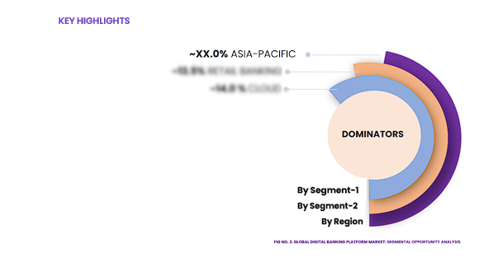
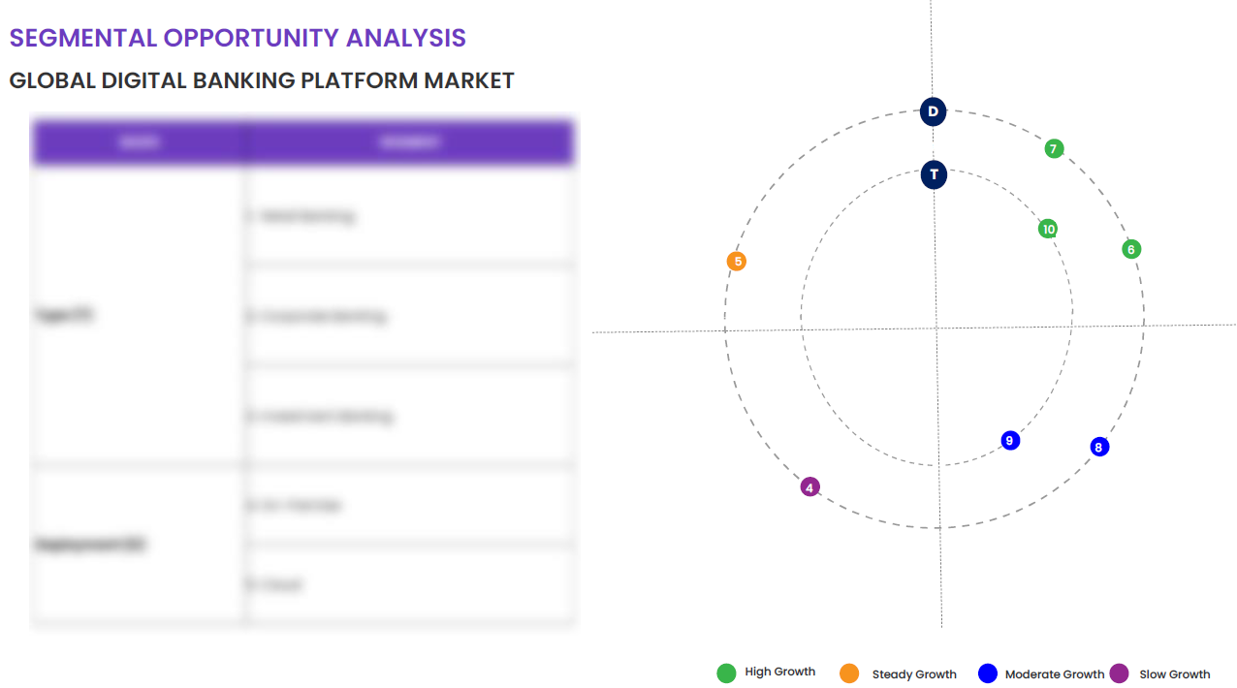
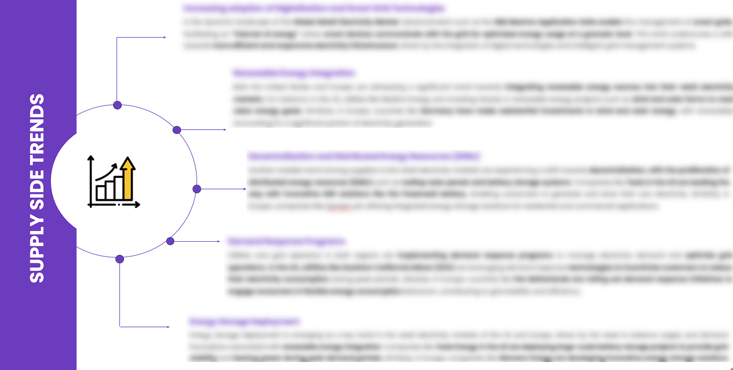
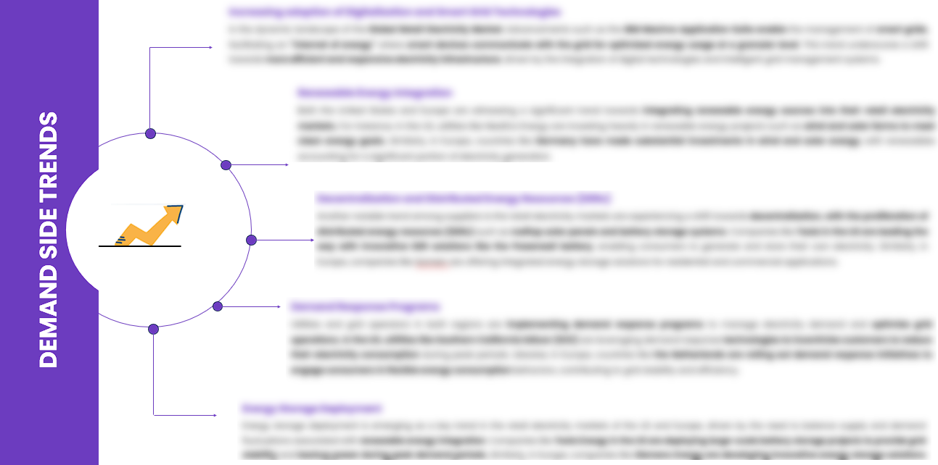
EXECUTIVE SUMMARY
SEGMENTAL OPPORTUNITY ANALYSIS
Global Sea Food Market
Global Sea Food Market,2024
102 Billion
Global Sea Food Market,2032
700 Billion
SUPPLY SIDE TRENDS
DEMAND SIDE TRENDS

Slide 16
MARKET OVERVIEW
Market Drivers & Challenges
Market Attractiveness - Porters Five Analysis
Threat of New Entrants
Bargaining Power of Suppliers
Bargaining Power of Buyers
Threat of Substitute
Intensity of Competitive Rivalry
Global Sea Food Market -
Historic Year 2019-2023 and Forecast to 2032

Slide 17
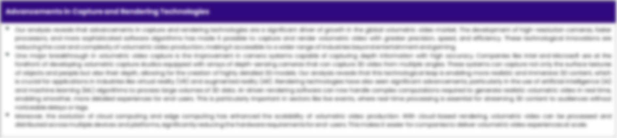
MARKET OVERVIEW: MARKET DRIVERS & OPPORTUNITIES
The Expanding Global Industry As A Key Driver For Global Sea Food Market
The increasing growth and diversification of the type industry, primarily the print and electronic media, have generated a considerable increase in the demand for sea food globally. The type industry has utilized written, visual, and audible content to advertise and promote seafood cultural delicacies, creating awareness and appetites for different types of seafood. As a result, this fosters a wider customer base that increases the consumption rates of seafood and thereby stimulates its global market. Additionally, the progressive evolution of the type industry is making room for biographical documentaries about sea creatures, their nutritional benefits, and sustainable fishing methods, which is indirectly facilitating the growth of the global seafood market. The use of various fonts, pictures, videos, and stories conveyed through the type industry provides a robust platform that helps in marketing seafood products, reaching a large audience, and driving higher sales.

Slide 18
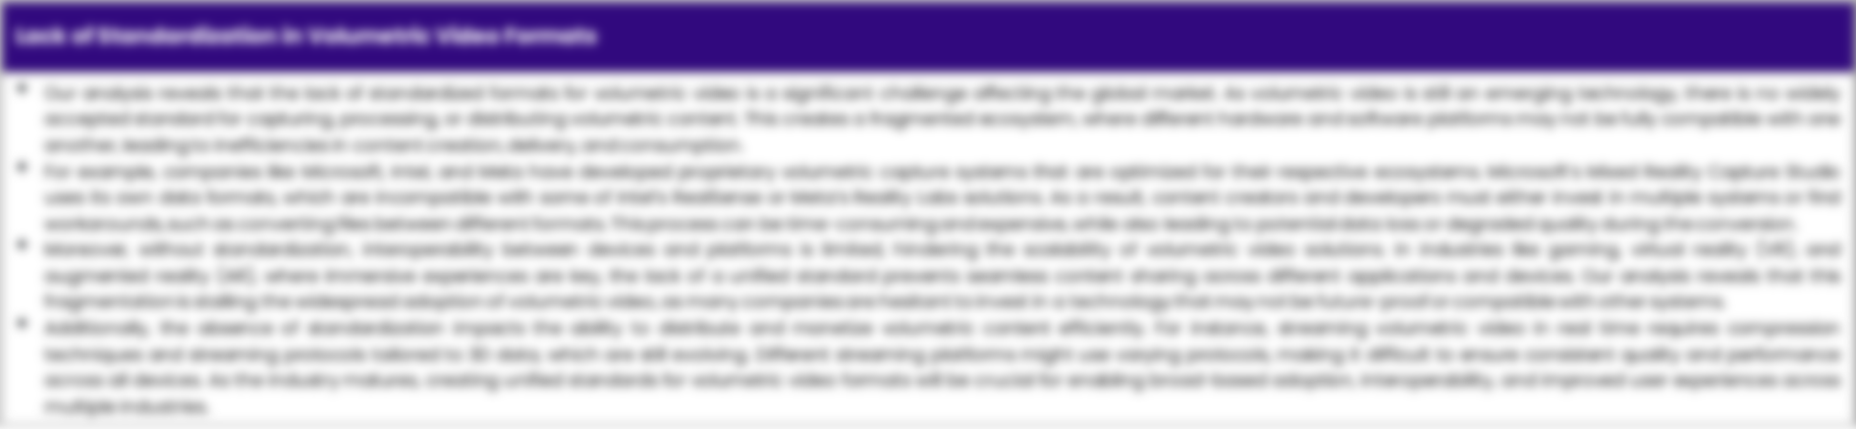
MARKET OVERVIEW: MARKET RESTRAINTS & CHALLENGES
High Initial Investment And Setup Costs Are Posing Challenge To The Growth Of The Market
The global seafood market is facing significant hurdles in terms of growth due to the high initial investment and setup costs required. Establishing infrastructures such as fishing vessels, breeding farms, processing facilities, and temperature-controlled transportation systems involves a substantial amount of capital. Start-ups, in particular, find it difficult to gather such huge investments which may discourage their participation, leading to less competitiveness and innovation in the market. The dynamics of the seafood market are complex and navigating these waters often requires sophisticated and expensive technologies to ensure quality and safety. Elaborate regulations, licensing procedures, and the need to conform with sustainability standards further add to the setup costs. These high expenses might overshadow the potential profit margins, reducing the incentive for both existing and potential businesses to increase their investments, and thereby impacting the overall growth of the global seafood market.

Slide 19




MARKET OVERVIEW

Slide 20
KEY MARKET INSIGHTS
Top Investment and White Space Opportunities
Market Ecosystem Mapping
Technological Advancements, Benefits, & Impacts
Market Attractiveness Index, 2024
PESTEL Analysis
Macro-Economic Indicators
Pricing Analysis
Regulatory Landscape
Key Success Factors
Market Impacting Factors
Patent Analysis
Raw Material Analysis
Global Sea Food Market-
Historic Year 2019-2023 and Forecast to 2032

Slide 21




KEY MARKET INSIGHTS

Slide 22
GLOBAL MARKET ANALYSIS, SEGMENTAL ANALYSIS
By Type, By Product Type, By Nature, By Distribution Channel
Global Sea Food Market-
Historic Year 2019-2023 and Forecast to 2032

Slide 23

GLOBAL MARKET ANALYSIS – BY Type
Global Sea Food Market SIZE, BY Type, 2019-2023 (USD Billion)
Key Takeaways
 | 2019 | 2020 | 2021 | 2022 | 2023 | 2024 | 2025 | 2026 | 2027 | 2028 | 2029 | 2030 | 2031 | 2032 | CAGR (2025–2032)
Fish | XX | XX | XX | XX | XX | XX | XX | XX | XX | XX | XX | XX | XX | XX | XX%
Crustaceans | XX | XX | XX | XX | XX | XX | XX | XX | XX | XX | XX | XX | XX | XX | XX%
Mollusks | XX | XX | XX | XX | XX | XX | XX | XX | XX | XX | XX | XX | XX | XX | XX%
Others | XX | XX | XX | XX | XX | XX | XX | XX | XX | XX | XX | XX | XX | XX | XX%
Total | XX | XX | XX | XX | XX | XX | XX | XX | XX | XX | XX | XX | XX | XX | XX%
*Please note that this slide represents an indicative segmentation overview. the complete level-2 segmentation analysis will be covered in the Final Report.

Slide 24
GLOBAL MARKET ANALYSIS BY REGION
Global Sea Food Market -
Historic Year 2019-2023 and Forecast to 2032

Slide 25


GLOBAL MARKET ANALYSIS BY REGION
Global Sea Food Market: REGIONAL ANALYSIS, 2019-2023 (USD Billion)
Key Takeaways
Europe
North America secured the foremost market share at 30.4%, and this dominance is projected to persist through the forecast period. This stronghold is attributed to the region's dense concentration of market competitors and an upsurge in cancer incidence rates. Notably, the U.S. witnessed approximately 1,806,590 new cancer diagnoses in 2020, as reported by the National Cancer Institute. The continuous integration of novel technologies, incorporating artificial intelligence, and the frequent launch of low-radiation CT scans are anticipated to further contribute to the region's market growth.
Conversely, Asia Pacific is poised for noteworthy growth, projected to experience a substantial Compound Annual Growth Rate (CAGR) over the forecast period. This surge can be attributed to the ongoing development of healthcare infrastructure, particularly in burgeoning economies such as India and China. The region's high adoption rate of advanced medical imaging devices, coupled with the increasing prevalence of chronic disorders, further fuels market expansion. Notably, local manufacturers in the region are gaining prominence, bolstering market growth.
North America
APAC
MEA
Latin America
Region | 2019 | 2020 | 2021 | 2022 | 2023 | 2024 | 2025 | 2026 | 2027 | 2028 | 2029 | 2030 | 2031 | 2032 | CAGR (2025-2032)
North America | XX | XX | XX | XX | XX | XX | XX | XX | XX | XX | XX | XX | XX | XX | XX%
Europe | XX | XX | XX | XX | XX | XX | XX | XX | XX | XX | XX | XX | XX | XX | XX%
Asia-Pacific | XX | XX | XX | XX | XX | XX | XX | XX | XX | XX | XX | XX | XX | XX | XX%
Latin America | XX | XX | XX | XX | XX | XX | XX | XX | XX | XX | XX | XX | XX | XX | XX%
Middle East & Africa | XX | XX | XX | XX | XX | XX | XX | XX | XX | XX | XX | XX | XX | XX | XX%
Total | XX | XX | XX | XX | XX | XX | XX | XX | XX | XX | XX | XX | XX | XX | XX%

Slide 26
NORTH AMERICA MARKET ANALYSIS – BY Type
NORTH AMERICA Global Sea Food Market SIZE, BY Type, 2019-2023 (USD Billion)
 | 2019 | 2020 | 2021 | 2022 | 2023 | 2024 | 2025 | 2026 | 2027 | 2028 | 2029 | 2030 | 2031 | 2032 | CAGR (2025–2032)
Fish | XX | XX | XX | XX | XX | XX | XX | XX | XX | XX | XX | XX | XX | XX | XX%
Crustaceans | XX | XX | XX | XX | XX | XX | XX | XX | XX | XX | XX | XX | XX | XX | XX%
Mollusks | XX | XX | XX | XX | XX | XX | XX | XX | XX | XX | XX | XX | XX | XX | XX%
Others | XX | XX | XX | XX | XX | XX | XX | XX | XX | XX | XX | XX | XX | XX | XX%
Total | XX | XX | XX | XX | XX | XX | XX | XX | XX | XX | XX | XX | XX | XX | XX%
Key Takeaways
*Please note that this slide represents an indicative segmentation overview. the complete level-2 segmentation analysis will be covered in the Final Report.

Slide 27
U.S. MARKET ANALYSIS – BY Type
U.S. Global Sea Food Market SIZE, BY Type, 2019-2023 (USD Billion)
 | 2019 | 2020 | 2021 | 2022 | 2023 | 2024 | 2025 | 2026 | 2027 | 2028 | 2029 | 2030 | 2031 | 2032 | CAGR (2025–2032)
Fish | XX | XX | XX | XX | XX | XX | XX | XX | XX | XX | XX | XX | XX | XX | XX%
Crustaceans | XX | XX | XX | XX | XX | XX | XX | XX | XX | XX | XX | XX | XX | XX | XX%
Mollusks | XX | XX | XX | XX | XX | XX | XX | XX | XX | XX | XX | XX | XX | XX | XX%
Others | XX | XX | XX | XX | XX | XX | XX | XX | XX | XX | XX | XX | XX | XX | XX%
Total | XX | XX | XX | XX | XX | XX | XX | XX | XX | XX | XX | XX | XX | XX | XX%
Key Takeaways
*Please note that this slide represents an indicative segmentation overview. the complete level-2 segmentation analysis will be covered in the Final Report.

Slide 28
COMPETITIVE DASHBOARD Top 5 Players Comparison Market Positioning of Key Players, 2023 Strategies Adopted By Key Market Players Recent Development Market Share Analysis, 2023
Global Sea Food Market -
Historic Year 2019-2023 and Forecast to 2032

Slide 29




COMPETITIVE DASHBOARD
Why SkyQuest ?
Global 3D Printing Construction Market Competition Dashboard
The following figure represents the market positioning of Global Sea Food Market players for the year 2023. The market positioning of the leading player is done considering the following points:

Slide 30
COMPETITIVE DASHBOARD
COMPETITORS | Atlantic Seafood Corporation | Company 2 | Company 3 | Company 4 | Company5
Headquarters | New York, USA | - | - | - | -
No of Employees | 10,000+ | - | - | - | -
Revenue (US$) 2023 | 1.35 | - | - | - | -
Segmental Revenue (US$) 2024 | - | - | - | - | -
Product Overview | - | - | - | - | -
Geographic Presence | Global - 50+ countries | - | - | - | -
Year of Establishment | 1995 | - | - | - | -
Market Position | - | - | - | - | -

Slide 31
COMPANY PROFILES
Global Sea Food Market -
Historic Year 2019-2023 and Forecast to 2032

Slide 32

Atlantic Seafood Corporation - COMPANY OVERVIEW
COMPANY AT A GLANCE
Established | 1995
Headquarter | New York, USA
Ownership | Public (NYSE: TECH)
Revenue (US$)- 2024 | 1.48
Employees | 10,000+
Website | www.example.com
OVERVIEW
Atlantic Seafood Corporation is a leading global provider in the Global Sea Food Market market, offering innovative solutions that drive digital transformation across industries. With over 25 years of experience, the company has established itself as a trusted partner for organizations seeking to leverage cutting-edge technology. The company's comprehensive portfolio includes advanced analytics, cloud solutions, and enterprise software that enable businesses to optimize operations and achieve sustainable growth. Through continuous innovation and strategic partnerships, Atlantic Seafood Corporation maintains its position at the forefront of technological advancement, serving thousands of clients worldwide.
PRODUCT OFFERING
PRODUCT NAME | DESCRIPTION
Advanced Technology Solutions

Slide 33
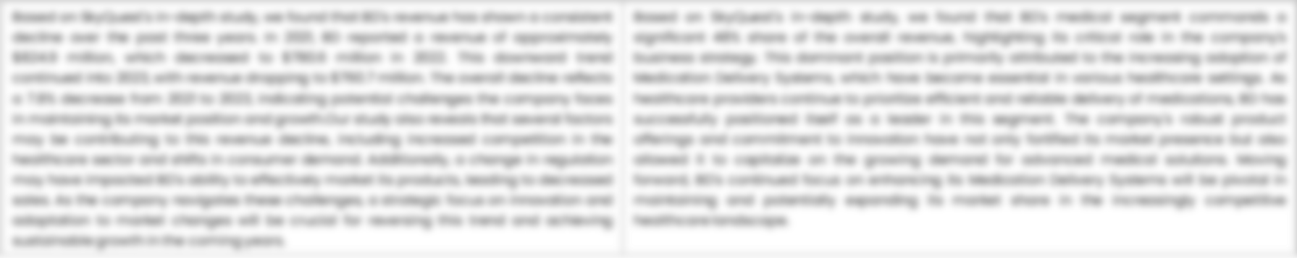
Atlantic Seafood Corporation - FINANCIAL OVERVIEW
Atlantic Seafood Corporation - RECENT FINANCIALS IN USD BILLION (2022-2024) | Atlantic Seafood Corporation - BUSINESS REVENUE MIX, 2024 IN PERCENTAGE (%)
SKYQUEST'S TAKE ON THE COMPANY

Slide 34

Atlantic Seafood Corporation – KEY DEVELOPMENTS
DATE | TYPE OF DEVELOPMENT | DESCRIPTION
October 2023 | Partnership | Microsoft and Siemens are deepening their partnership by bringing the benefits of generative AI to industries worldwide. As a first step, the companies are introducing Siemens Industrial Copilot, an AI-powered jointly developed assistant aimed at improving human-machine collaboration in manufacturing. In addition, the launch of the integration between Siemens Teamcenter software for product lifecycle management and Microsoft Teams will further pave the way to enabling the industrial metaverse.
May 2023 | Product launch | Microsoft Corp. announced a suite of new AI solutions and improvements to Microsoft Clumping Clay for Nonprofit that are designed to transform the nonprofit industry and how fundraisers engage with donors, manage campaigns and optimize operations. In addition, the company announced a limited private preview for nonprofits to experience a new AI-powered fundraising propensity model.

Slide 35
ABOUT US & APPENDIX

Slide 36











ABOUT US
Established in 2006, SkyQuest is a Global Market Intelligence, Innovation Management organization that connects innovation to new markets, networks & collaborators for achieving sustainable development goals.
SOME OF OUR CLIENTS
180+ Institutional Clients 125000+ Streaming Clients 500+ Workshops Organized
Sectoral Coverage
| Information Technology | Clean Tech | Marketing & Advertising | Water | Life Sciences and Social | Social | Energy and Power | Food & Beverage | Training & E-Learnings & Materials | Semiconductor & Electronics | Oil & Gas | Banking, Financial, Capital Markets, Insurance

Slide 37
OUR CUSTOMIZED RESEARCH CAPABILITIES
CUSTOMER, DISTRIBUTOR, SUPPLIER INTELLIGENCE
TYPE INTELLIGENCE SUPPORT
Identification of potential partners
Shortlisting/finalization of potential partners
Customer need analysis
Customer's purchase and usage behavior
Customer/partner feedback and satisfaction
Brand perception analysis
Import and Export Intelligence
Commodity pricing intelligence
Product pricing intelligence
Product Positioning Assessment
New product launch tracker
Product claims assessment
Product Concept Testing
COMPETITIVE DASHBOARD SUPPORT
MARKET INTELLIGENCE SUPPORT
Company profiling
Competition assessment incl. market share
Drilled down revenue estimations
Employer value proposition
Market size and segmentation
Growth opportunities
Market dynamics and new developments
Go to Market Strategies
DATA COLLECTION AND ANALYSIS SUPPORT
MARKET STRUCTURE ASSESSMENT
Data analytics and visualization
Data collection, manipulation incl. web scraping
B2B and B2C surveys and interviews
Macroeconomic analysis
Value Chain and Communication Analysis
Regulatory assessment
Coating layer scouting and assessment

Slide 38
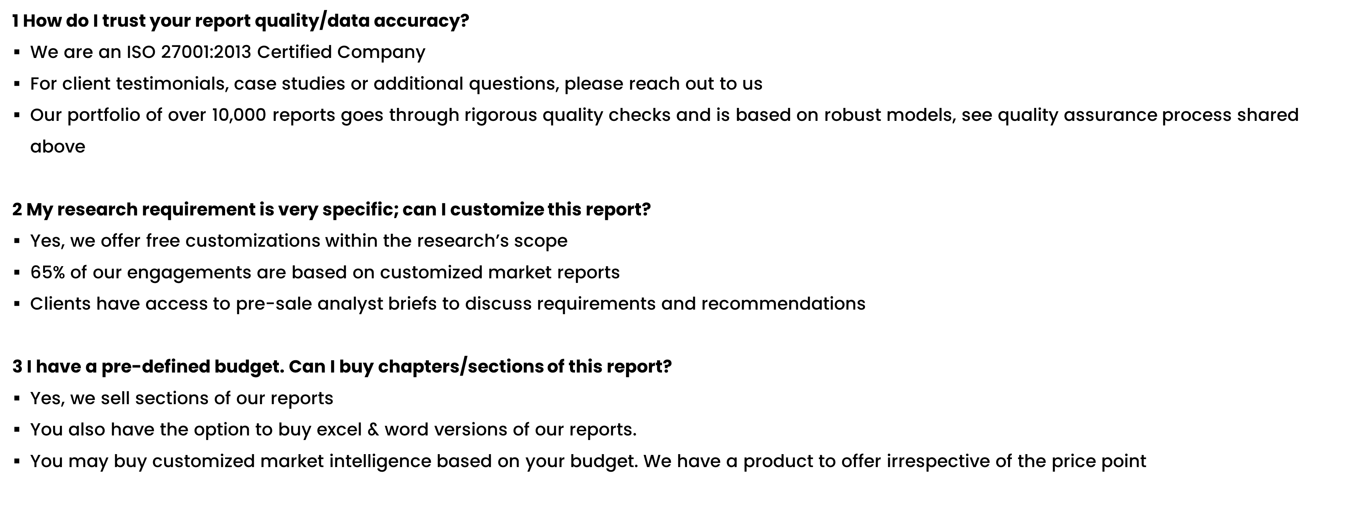
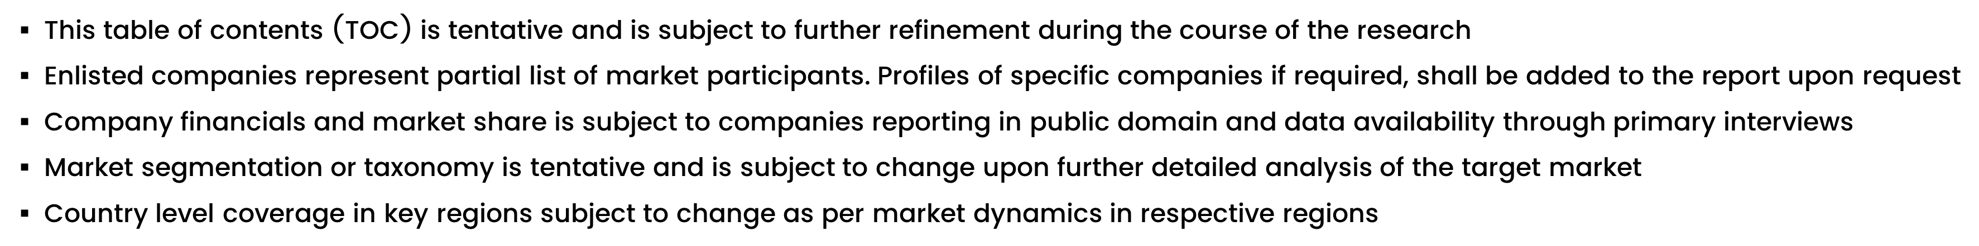
FAQs
NOTE

Slide 39






DISCLAIMER
SkyQuest provides strategic analysis to a select group of customers in response to orders. Our customers acknowledge when ordering that these strategic analysis for internal use and not for general publication or disclosure to any third party. SkyQuest does not endorse any vendor, product, or product type profiled in its publications. SkyQuest's strategic analysis constitutes estimations and projections based on secondary and primary research and are therefore subject to variations.
SkyQuest disclaims all warranties, expressed or implied, with respect to this research, including any warranties of merchantability or fitness, for any particular purpose. SkyQuest takes no responsibility for incorrect information supplied to it by manufacturers or users.
Trademarks, copyrights, and other forms of intellectual property belong to SkyQuest's respective owners and are protected by law. under no circumstance may any of these be reproduced, copied, or circulated in any form, without the prior written approval of SkyQuest's owner-as the case may be no part of this strategic analysis may be given, lent, resold, or disclosed to any third party, without express permission from SkyQuest team.
Reproduction and/or transmission in any form and by any means, including photocopying, mechanical, electronic, recording, or otherwise, without the permission of SkyQuest, is prohibited.
HEADQUARTERS
1 Apache Way, Westford, Massachusetts 01886, United States
APAC OFFICE
Room A & B, 2nd Floor, Lee Kee Commercial Building, 221-227, Queen’s Road Central, Hong Kong
GLOBAL DELIVERY CENTER
D-1001-1005, Swati Clover, Shilaj Circle, Sardar Patel Ring Rd, Thaltej, Ahmedabad, Gujrat-380054
WE ARE REACHABLE AT :-
info@skyquestt.com
+1-617-230-0741
www.skyquestt.com

Slide 40
THANK YOU
www.skyquestt.com

